Slide 1
Maryland Resident Cybersecurity Awareness and Practices Survey
Anton Dahbura, Joseph Carrigan, Jamie Stelnik and Mohammed Khalid
The Johns Hopkins University Information Security Institute
May 2023
AntonDahbura@jhu.edu
Funding for this work was provided by the National Cryptologic Foundation and the Johns Hopkins University Information Security Institute.

Slide 2
Outline
Background
Survey participants demographics
Participants’ cybersecurity and computer knowledge, and cybersecurity training
Participants’ cybersecurity hygiene practices
Interesting findings and recommendations

Slide 3
Background
The survey was been conducted by member of the Johns Hopkins University Information Security Institute (ISI).
Purpose: Survey Maryland residents to assess their familiarity with cybersecurity concepts and threats and to determine the extent to which they’re using best practices to prevent cyberattacks.
The survey allows participants to respond regarding their personal practices or their practices at their work, without distinguishing between the two.

Slide 4
Background (cont.)
The Amazon Mechanical Turk (MTurk) platform was used to recruit participants, conduct the survey, and gather results.
MTurk is a crowdsourcing website with which businesses can hire remotely located "crowdworkers" to perform discrete on-demand tasks.
Employers (known as requesters) post jobs known as Human Intelligence Tasks (HITs), such as identifying specific content in an image or video, writing product descriptions, or answering survey questions.
Workers, colloquially known as Turkers or crowdworkers, browse among existing jobs and complete them in exchange for a fee set by the employer. [Wikipedia]

Slide 5
Background (cont.)
The survey was conducted on MTurk from October 2022 through February 2023.
549 participants completed the survey and were paid $5 each.
The survey was listed as “Survey About Your Cybersecurity Habits” and participants were told that the survey would require approximately 10 minutes to complete.
Funding for the survey fees were provided by the National Cryptologic Foundation and ISI.

Slide 6
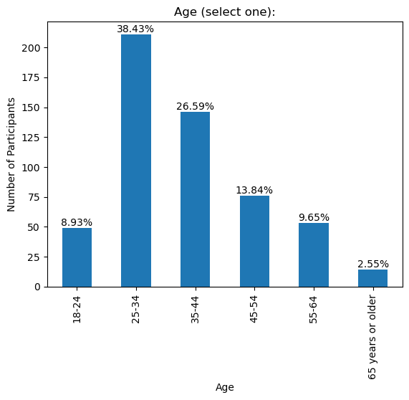
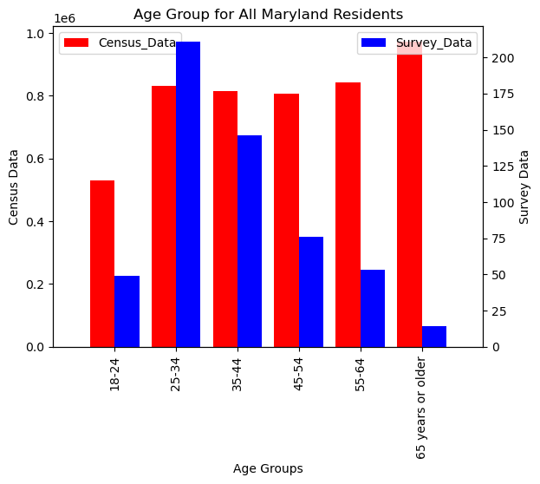
Participant Demographics- Age

Slide 7
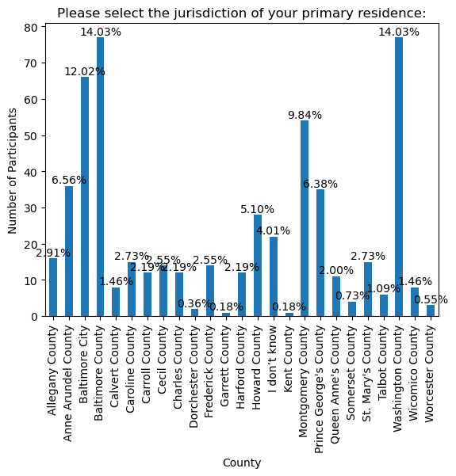
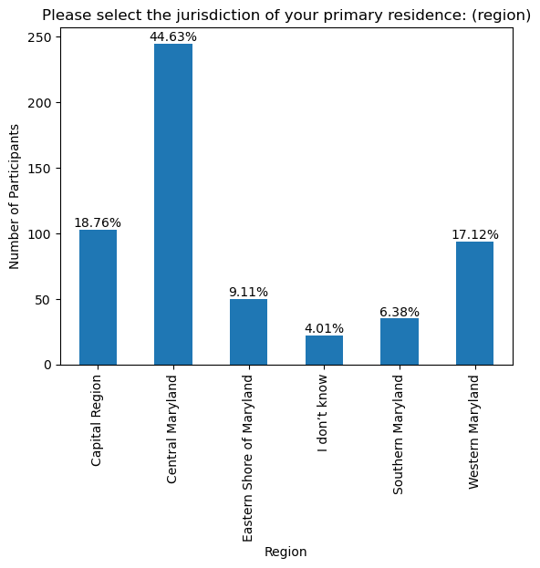
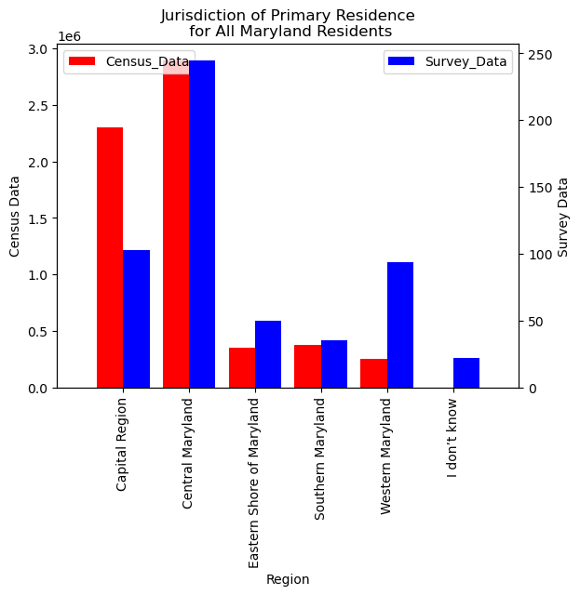
Participant Demographics- Location

Slide 8
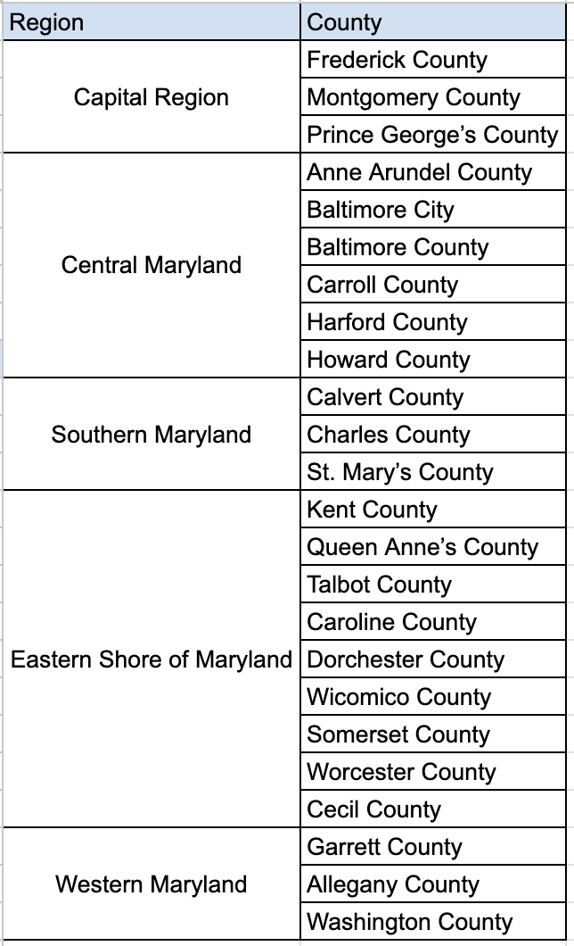

Slide 9
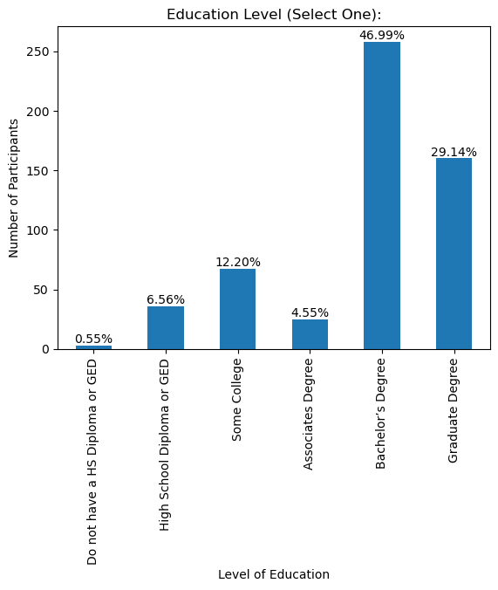
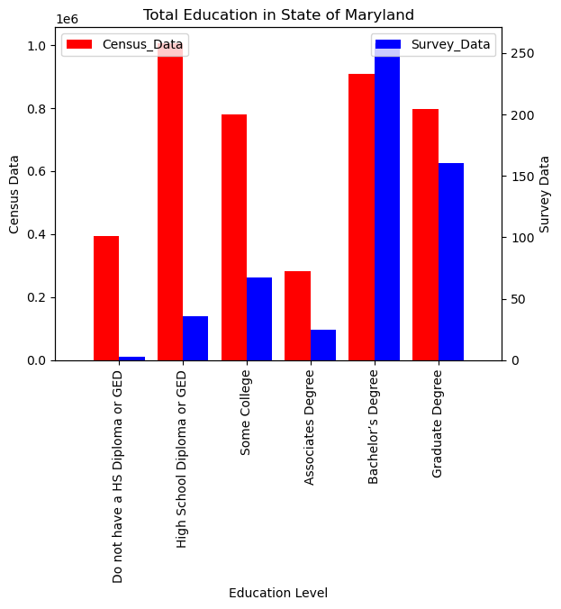
Participant Demographics- Education

Slide 10
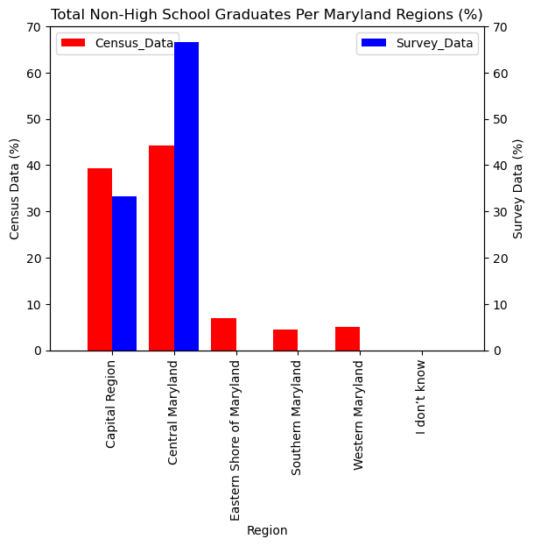
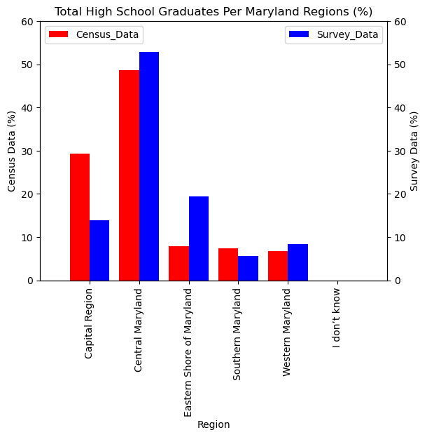
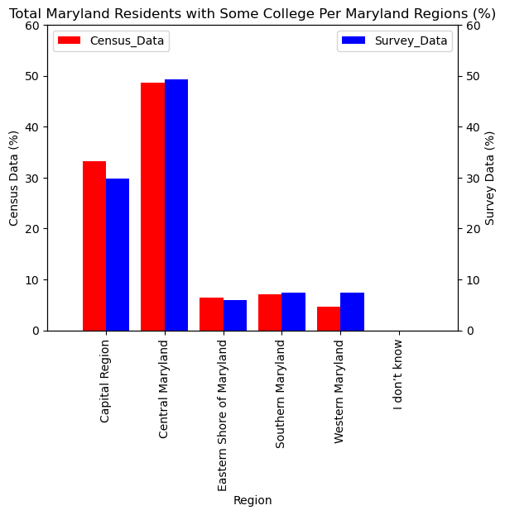
Participant Demographics- Education (cont.)
Non HS graduates High School Graduates Some College

Slide 11
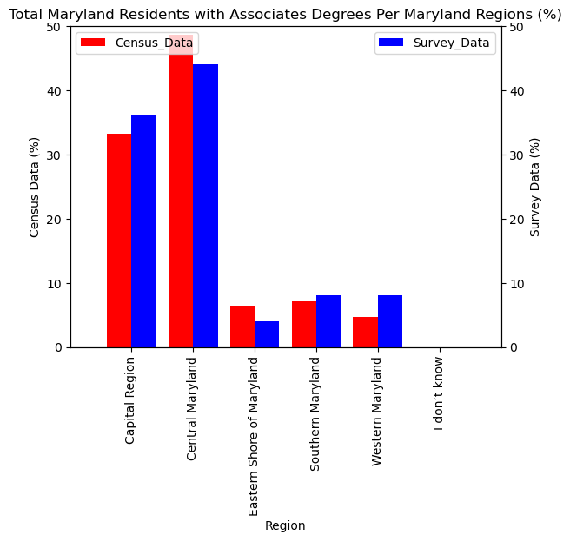
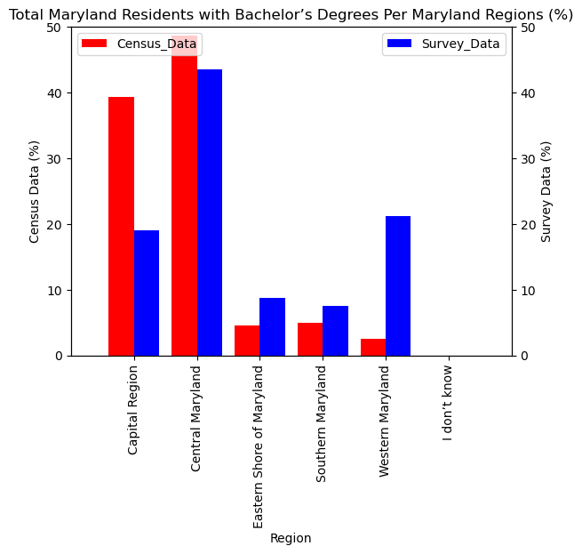
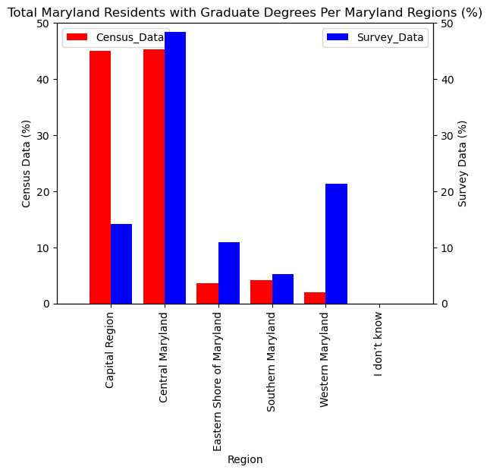
Participant Demographics- Education (cont.)
Associate Degree Bachelor’s Degree Graduate Degree

Slide 12
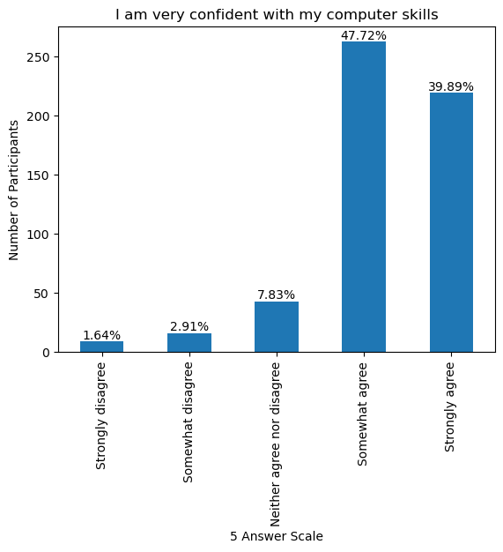
Demographics- Self-Assessed Computer Skills

Slide 13
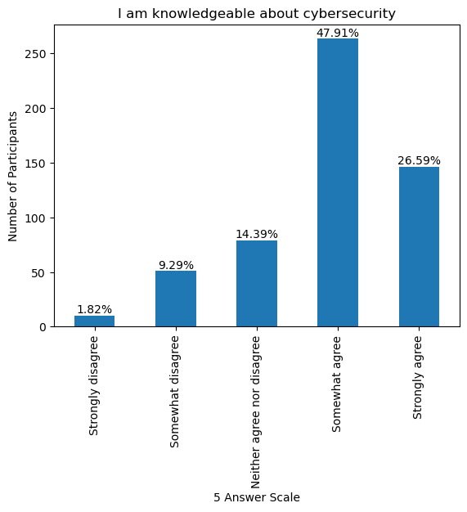
Demographics- Self-Assessed Cybersecurity Knowledge

Slide 14
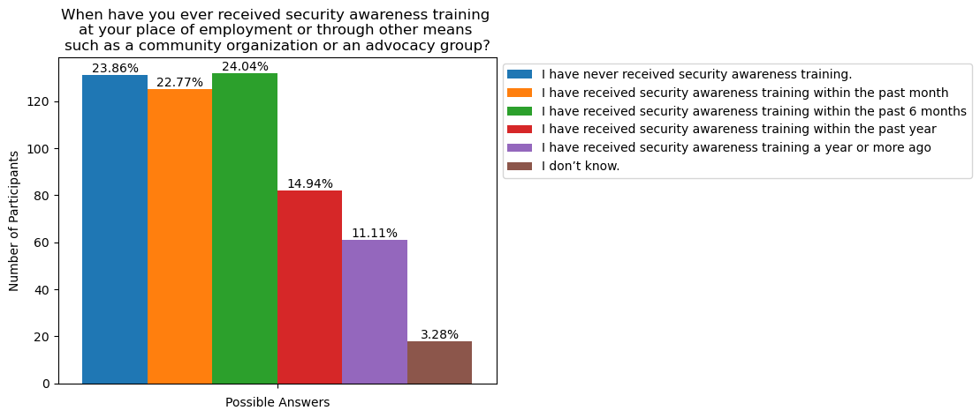
Demographics- Cybersecurity Awareness Training
About 67% of participants claim to have received
security awareness training within the past year.

Slide 15
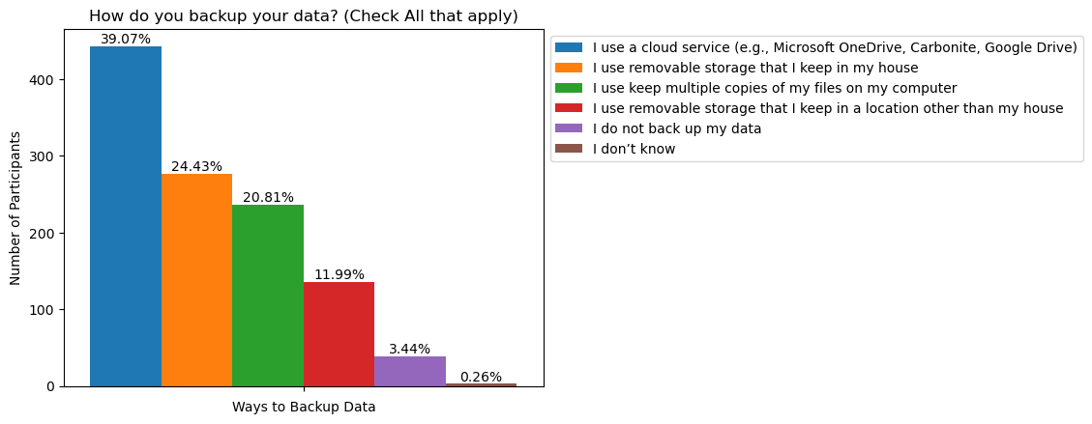
Cybersecurity Hygiene Questions
?

Slide 16
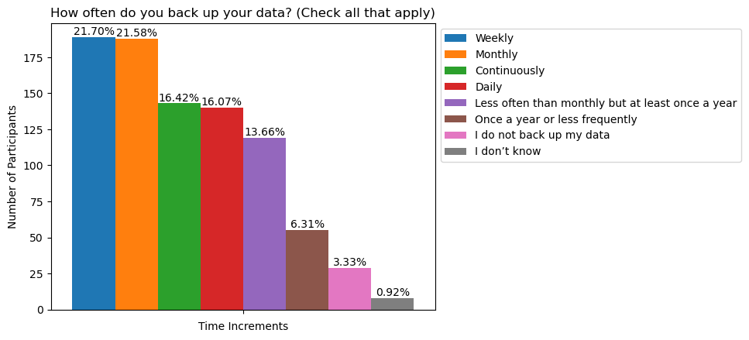

Slide 17
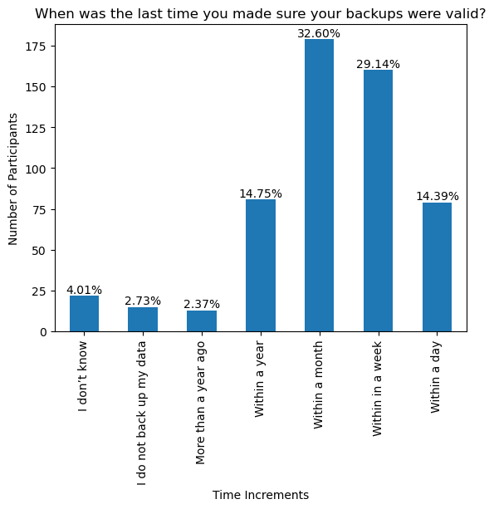
Over 90% of participants claim to have checked their backups.

Slide 18
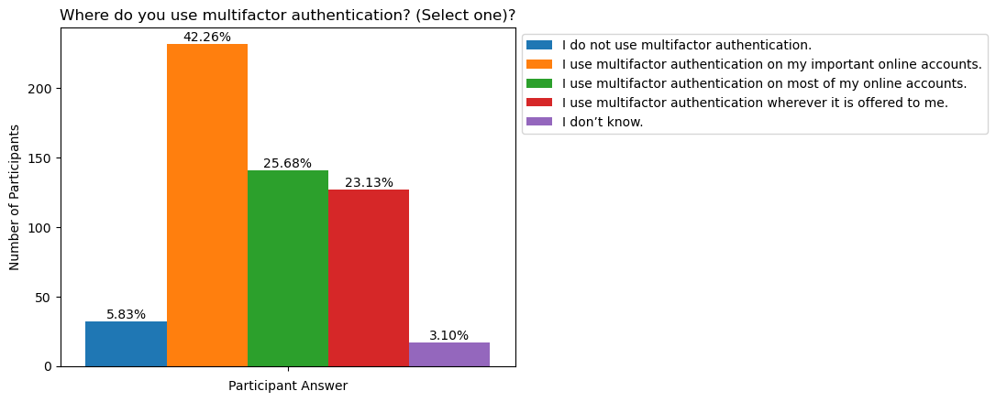

Slide 19
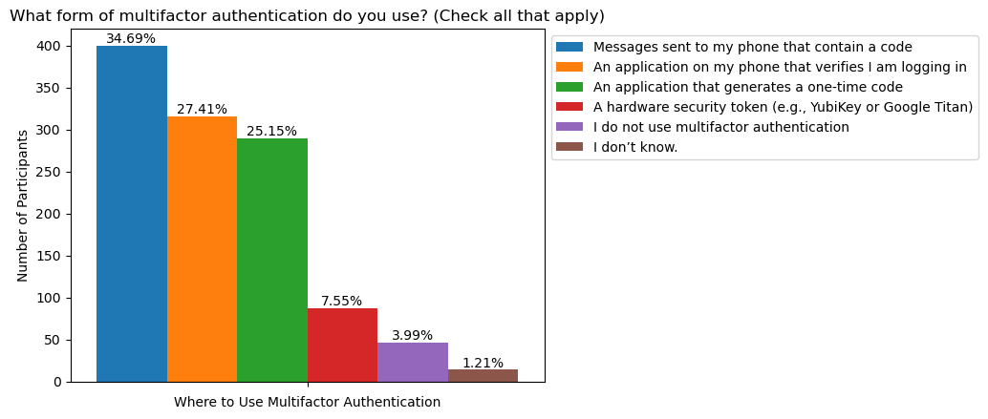

Slide 20
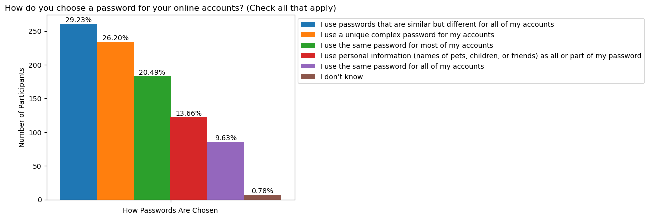

Slide 21
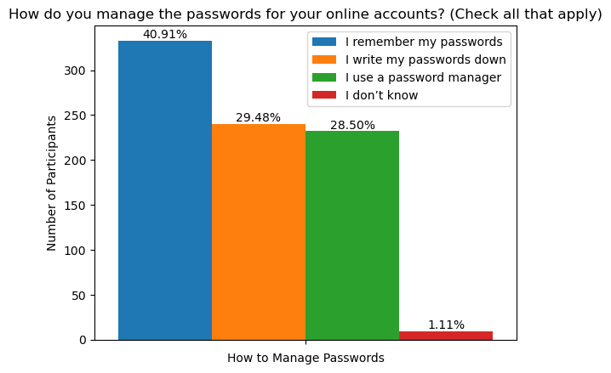

Slide 22
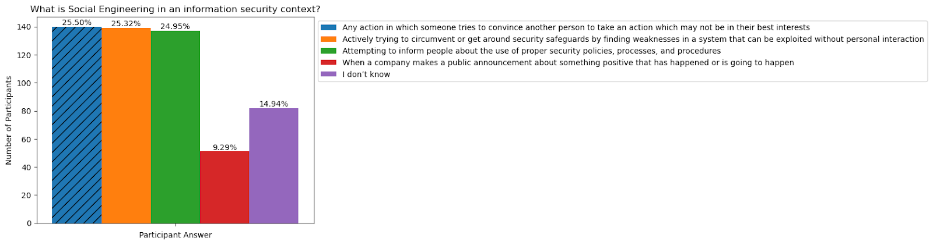
Quiz Question #1: What is Social Engineering?

Slide 23
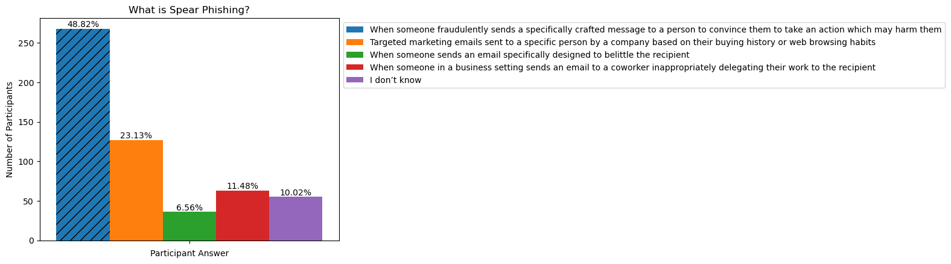
Quiz Question #2: What is Spear Phishing?

Slide 24
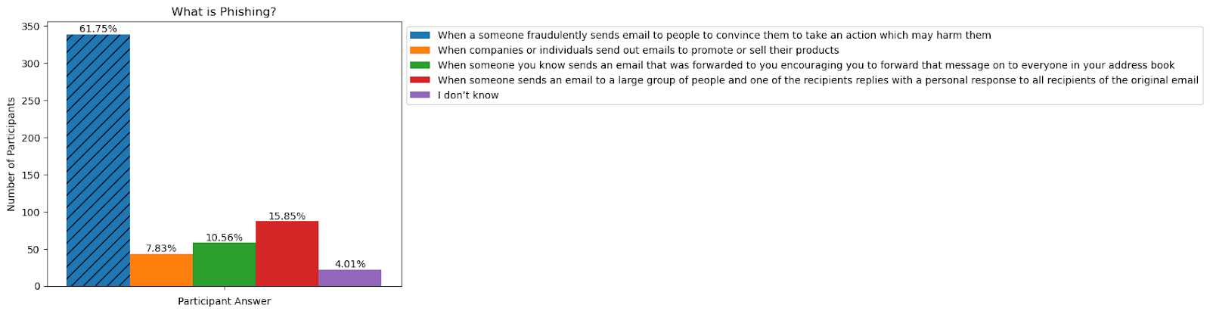
Quiz Question #3: What is Phishing?

Slide 25
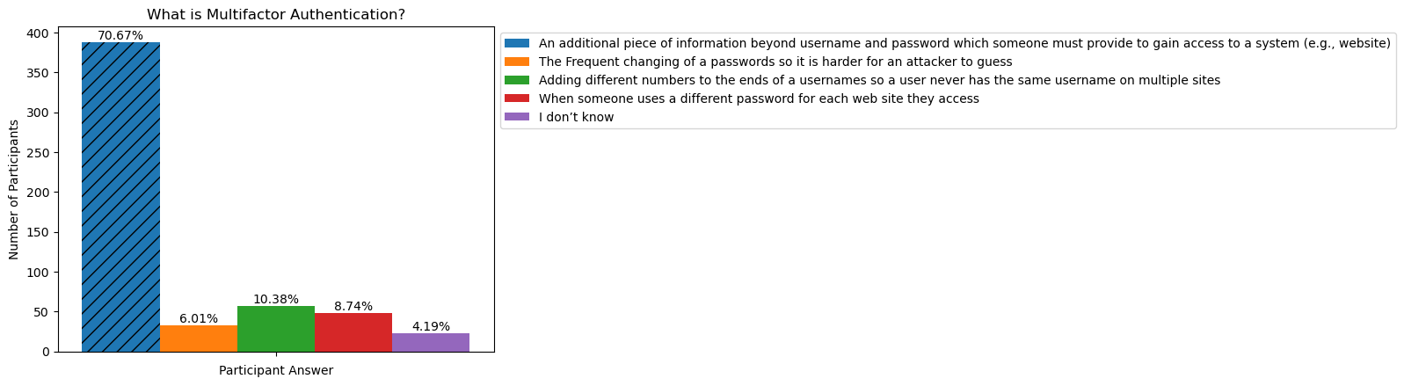
Quiz Question #4: What is Multifactor Authentication?

Slide 26
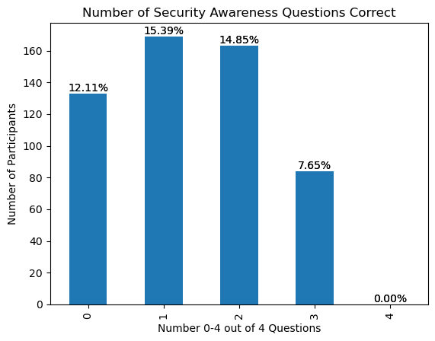

Quiz Question Scores (0-4 correct)

Slide 27
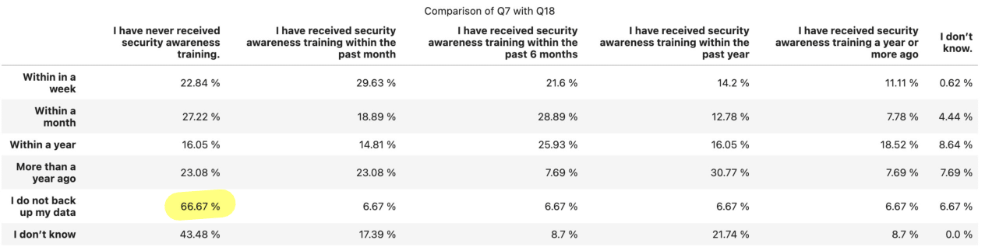
Last time checking backup as a function of training

Slide 28
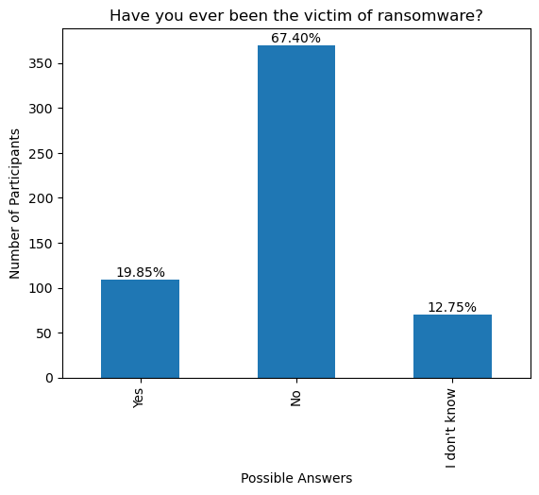
Scam Victim Questions

Slide 29
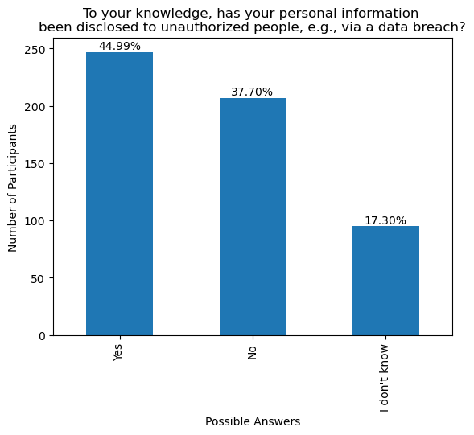
Almost everyone has had their
personal information disclosed to
unauthorized people!

Slide 30
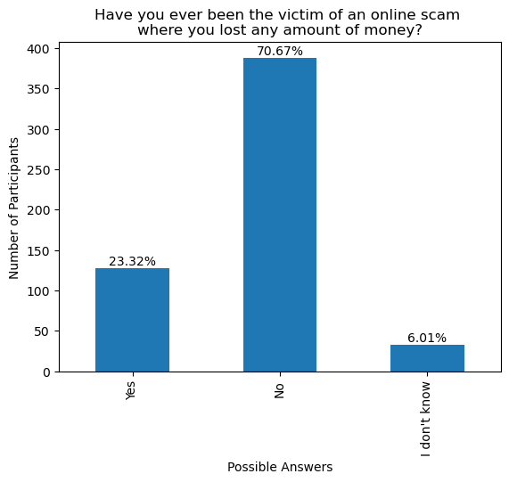

Slide 31
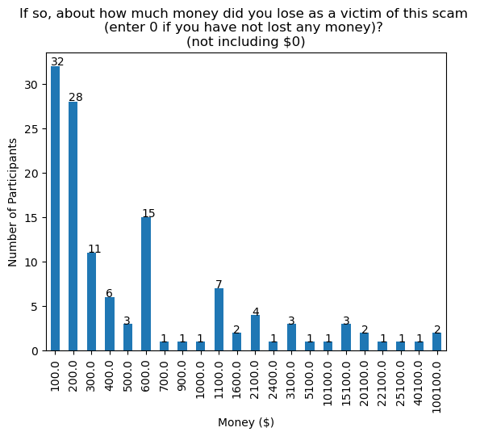
These 552 people claim to have lost over $436,098 due to on-line scams!
This projects to $3.8B for the 4.7M adults living in Maryland.

Slide 32
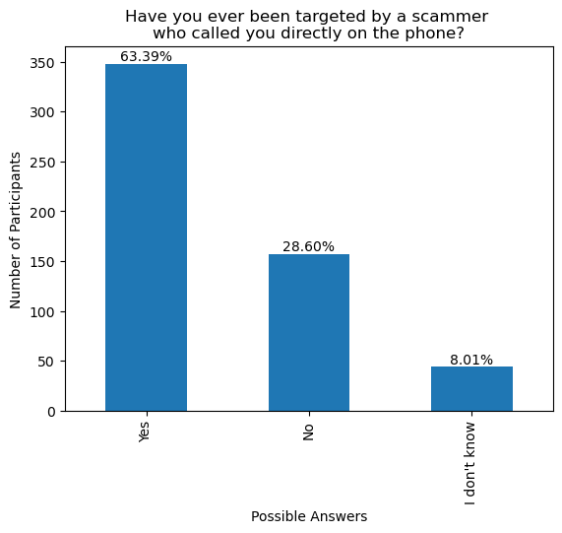

Slide 33
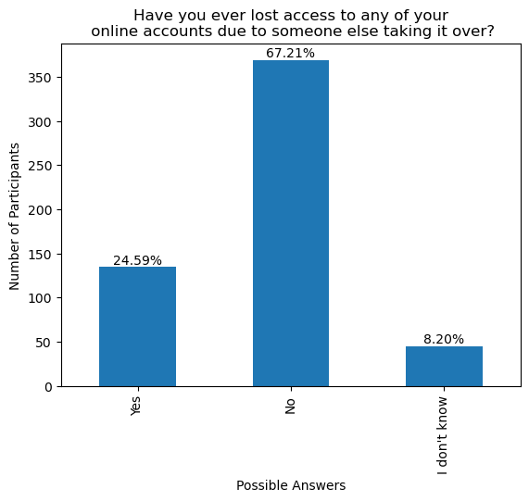

Slide 34
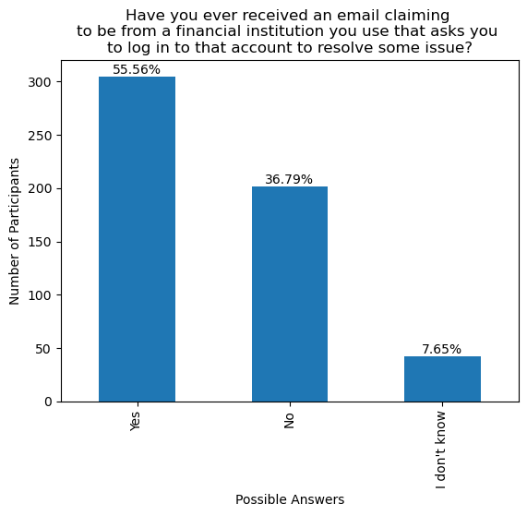

Slide 35
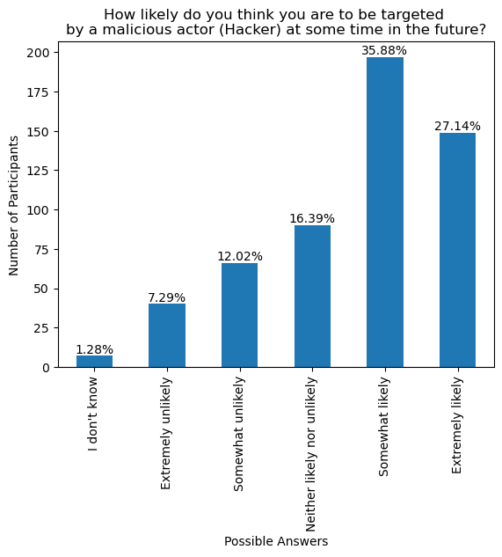

Slide 36
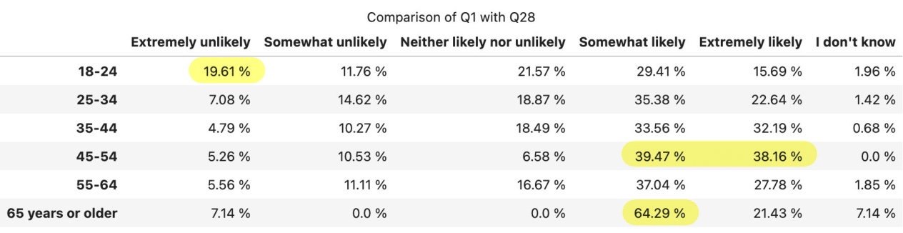

Slide 37
Interesting Findings
Even participants that self-assessed as knowledgeable about computers and cybersecurity had mixed cyber-hygiene practices and fared poorly on the basic knowledge questions.
An alarming number of Maryland residents have:
been victims of ransomware
been scammed for significant amounts of money
had their on-line accounts taken over
been victims of other scams/attempts
Younger participants (18-24) are more confident about avoiding being a victim of a cyber scam.

Slide 38
Recommendations
The State of Maryland needs to invest in more cybersecurity awareness and training for all of its residents!
Participation with the private sector? School system?
For a future survey:
change some of the questions
use interviews to obtain more accurate answers
collect gender data
if on Mturk (not recommended), find out more about Mturk participants
Partner with an organization that specializes in surveys
Compare with surveys from other states and perhaps build a regional or national alliance.

